Slide 1

Modifiers
.neT

Slide 2
Modifiers are C# keywords used to modify declarations of types (class, struct, interface, enum) and type members (fields, properties, methods, indexers, etc).
https://docs.microsoft.com/en-us/dotnet/csharp/language-reference/keywords/

Slide 3
Modifier vs. Access Modifier
A modifier determines the type of object it is
An Access Modifier determines what other parts of code can access and manipulate that object.

Slide 4
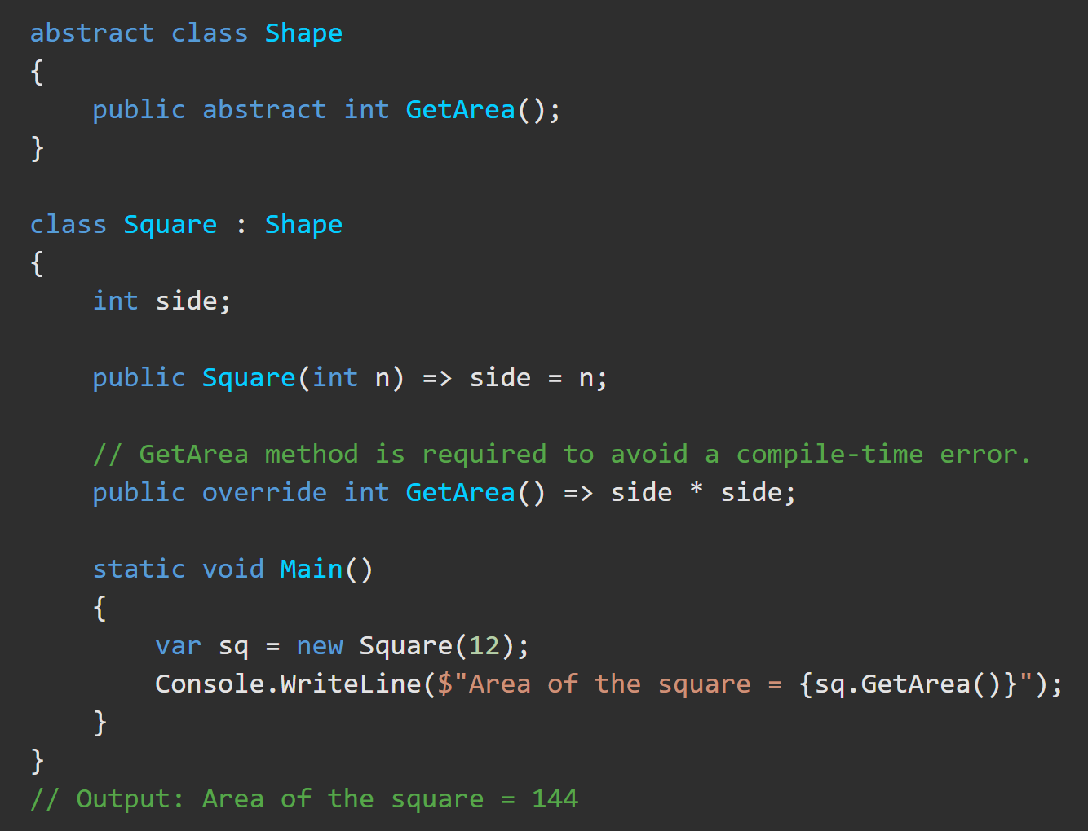
Modifiers – Abstract https://docs.microsoft.com/en-us/dotnet/csharp/language-reference/keywords/abstract
abstract means that the thing being modified has a missing or incomplete implementation.
intended only to be a base class of other classes,
NOT instantiated on their own.
classes, methods, properties, indexers, and events can be abstract
Members marked as abstract must be implemented by non-abstract classes that derive from the abstract class.

Slide 5
Modifiers – Abstract https://docs.microsoft.com/en-us/dotnet/csharp/language-reference/keywords/abstract
Abstract CLASSES…
cannot be instantiated.
may contain abstract methods and accessors.
must provide implementation for all implemented interface members.
Cannot include the sealed modifier.
Abstract METHODS…
An abstract method is implicitly a virtual method.
Abstract methods are only permitted in abstract classes.
Do not have method body. ( {} )
Only have an implementation in derived class methods using override keyword.
Cannot have the static or virtual modifiers.
Abstract PROPERTIES…
All characteristics of methods are also true for properties.
Abstract properties are written with { get; set; } but do NOT have an implementation.
The getter and setter of the { get; set; } can be expanded to include custom validation or encapsulation

Slide 6
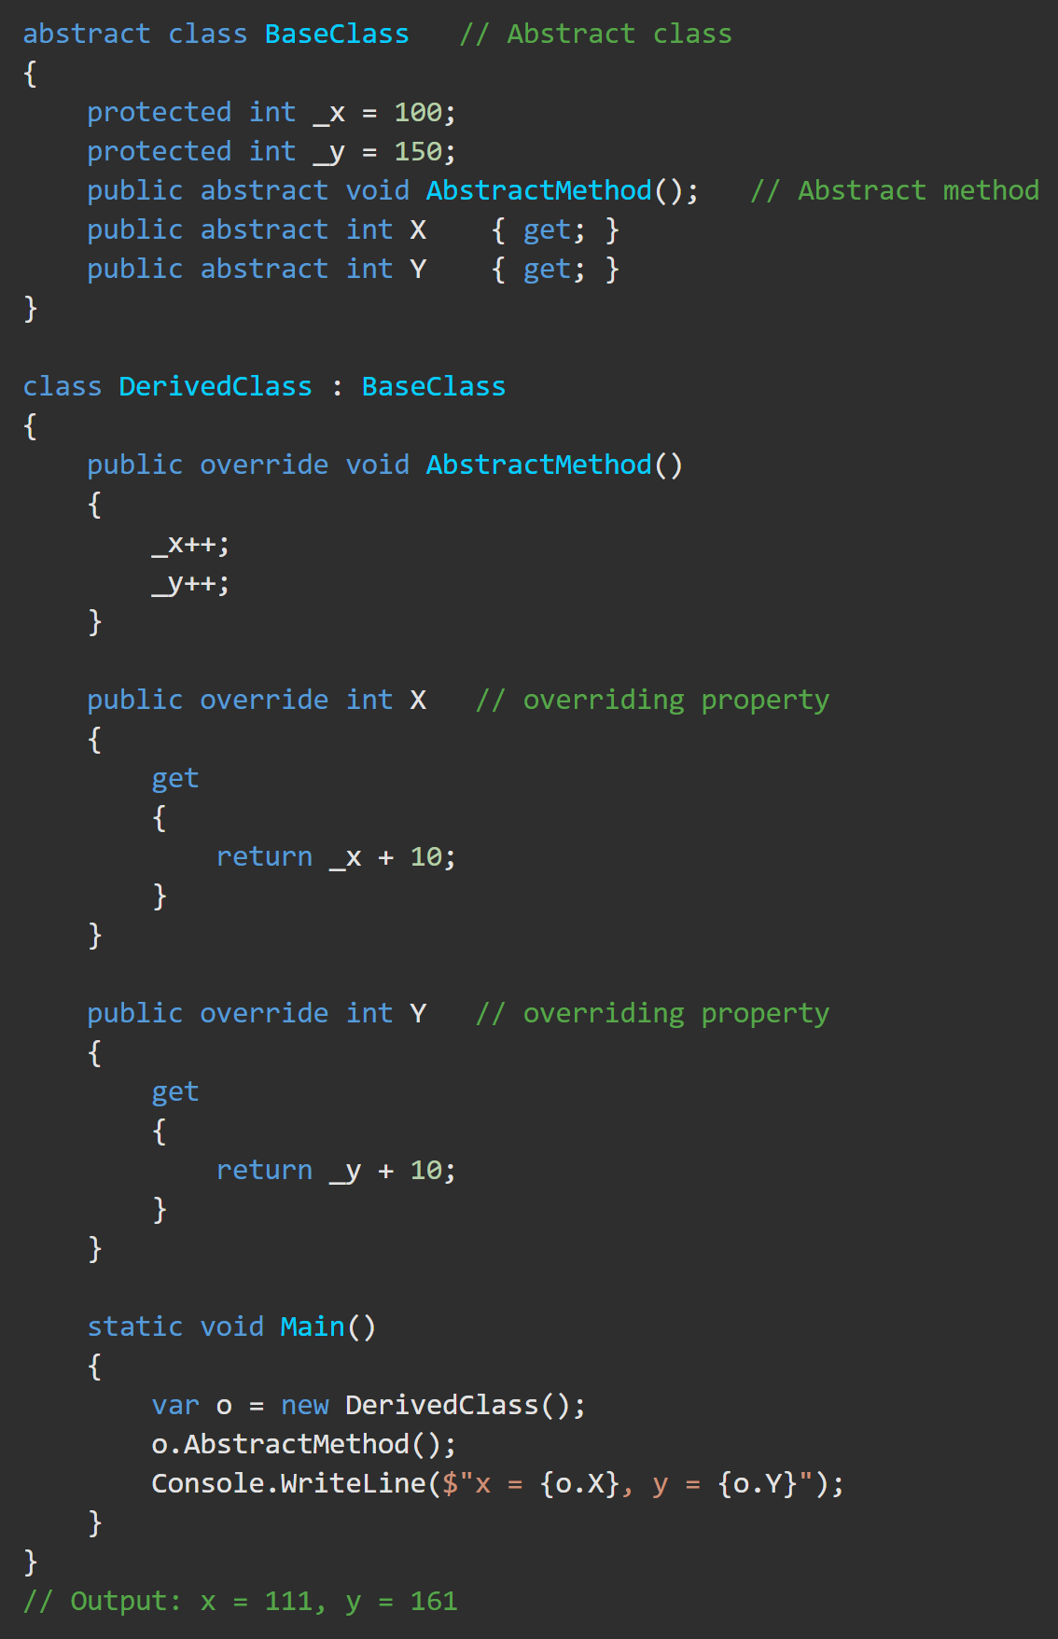

Modifiers – Abstract https://docs.microsoft.com/en-us/dotnet/csharp/language-reference/keywords/abstract
DerivedClass is derived from the abstract class, BaseClass. The abstract class contains an abstract method, AbstractMethod(), and two abstract properties, x and y.
An attempt to instantiate the abstract class by using the below statement gets an error:
The compiler cannot create an instance of the abstract class 'BaseClass'.

Slide 7
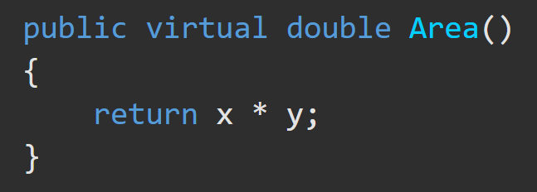
Modifiers – Virtual https://docs.microsoft.com/en-us/dotnet/csharp/language-reference/keywords/virtual
The virtual keyword is used to modify a method, property, indexer, or event declaration and allow for it to be overridden in a derived class.
The implementation of a virtual member can be changed by an overriding member in a derived class.

Slide 8
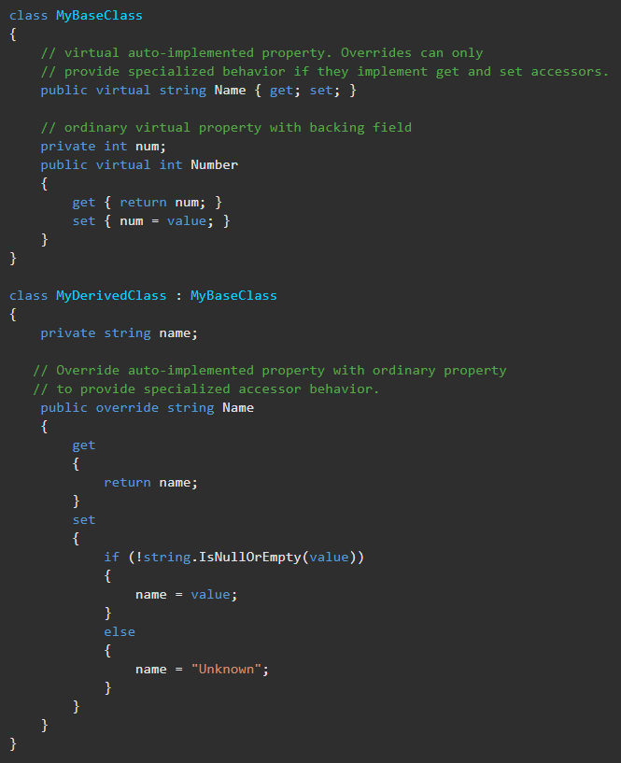
Modifiers – Virtual https://docs.microsoft.com/en-us/dotnet/csharp/language-reference/keywords/virtual
By default, methods are non-virtual.
You cannot override a non-virtual method.
You cannot use the virtual modifier with the static, abstract, private, or override modifiers.
A virtual inherited property can be overridden by using the override modifier.

Slide 9
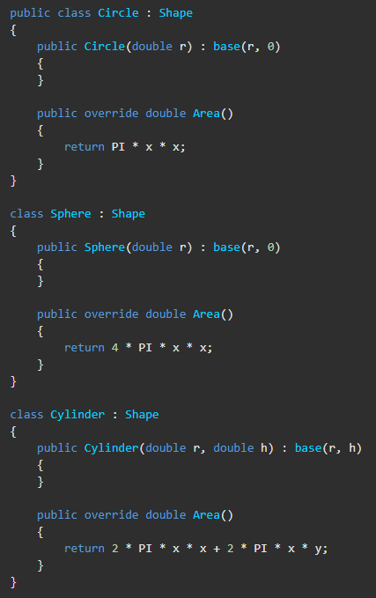
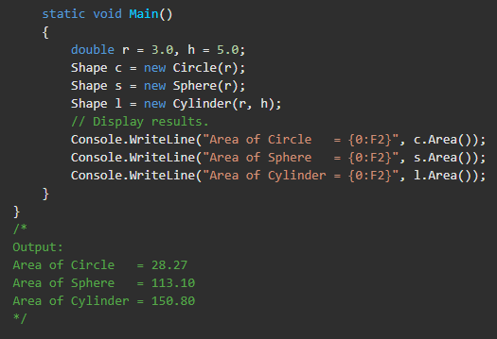
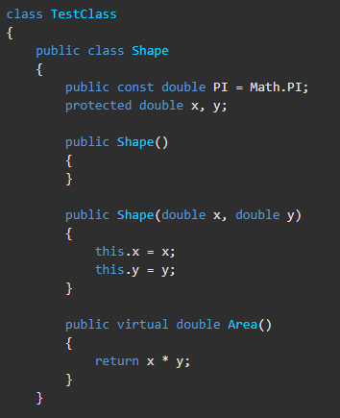
Modifiers – Virtual https://docs.microsoft.com/en-us/dotnet/csharp/language-reference/keywords/virtual
The Shape class contains two coordinates (x, y) and the Area() virtual method. Classes Circle, Cylinder, and Sphere inherit from Shape. Each derived class has its own override implementation of Area(). This means that the surface area is calculated for each shape type within that class.

Slide 10
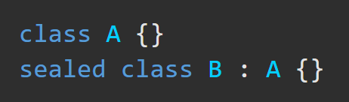
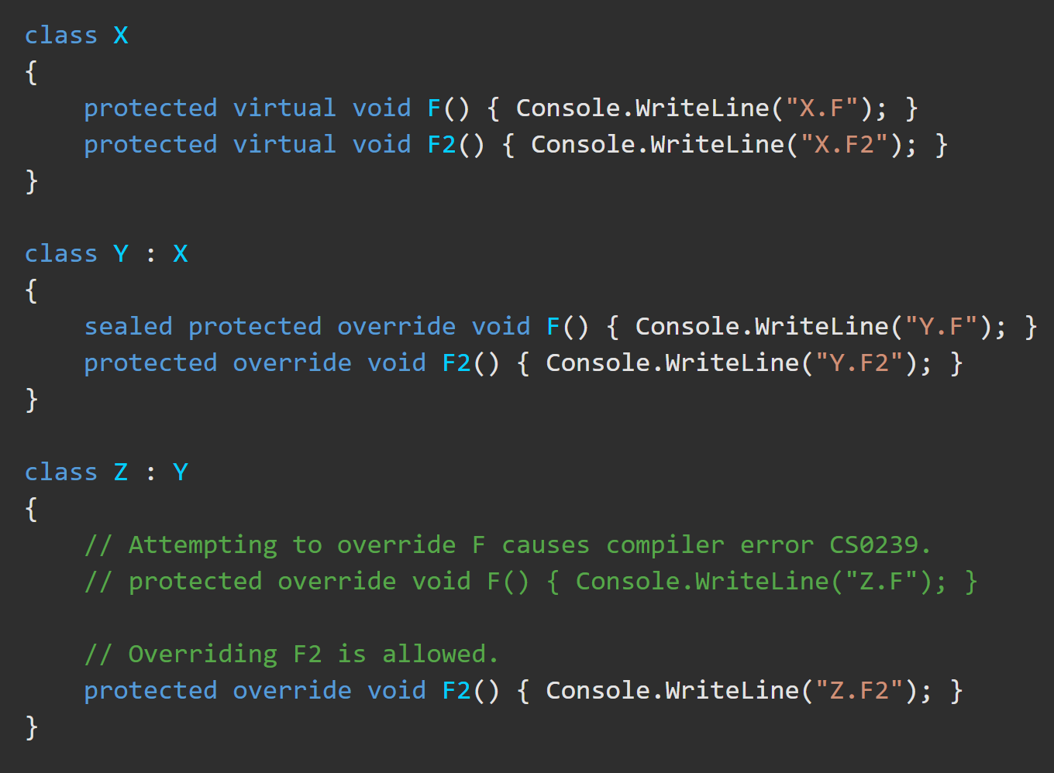
Modifiers – Sealed https://docs.microsoft.com/en-us/dotnet/csharp/language-reference/keywords/sealed
The sealed modifier prevents inheritance from a class.
The sealed modifier can prevent an overriding method from being overridden by a more derived method.
In this example, Z inherits from Y but Z cannot override the virtual function F that is declared in X and sealed in Y.

Slide 11


Modifiers – Sealed https://docs.microsoft.com/en-us/dotnet/csharp/language-reference/keywords/sealed
Modifiers – Sealed https://docs.microsoft.com/en-us/dotnet/csharp/language-reference/keywords/sealed
When should you use Sealed? Consider…
The potential benefits that deriving classes might gain through the ability to customize your class.
The potential that deriving classes could modify your classes in such a way that they would no longer work correctly or as expected.

Slide 12
Modifiers – Static https://docs.microsoft.com/en-us/dotnet/csharp/language-reference/keywords/static
Static CLASSES…
Cannot be instantiated or extended.
If a class is static, all It’s members must be static.
Essentially, just a container for static members.
ALL Static Members…
Cannot use this to reference static methods or property accessors.
Belongs to the class type itself rather than the specific object instance.
A static member is referenced through the types’ name.
(ex. ClassName.StructName.propName)

Slide 13
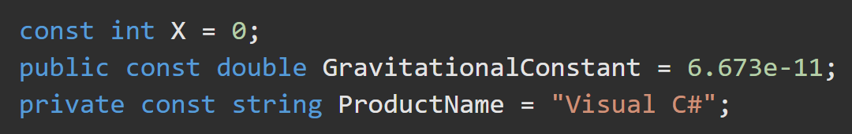
Modifiers – Const https://docs.microsoft.com/en-us/dotnet/csharp/language-reference/keywords/const
const fields and locals aren't variables and may not be modified.
const fields can be numbers (int, double, long, etc), boolean, string, or null.
The only reference types that can be const are string and a null reference.
The static modifier is not allowed in a const declaration.
const variables, by convention, are all UPPER CASE.

Slide 14
Modifiers – readonly https://docs.microsoft.com/en-us/dotnet/csharp/language-reference/keywords/readonly
The initialization of a readonly member can only occur as part of the class declaration or in a constructor in the same class.
readonly is like const, but initialization can be deferred until its constructor runs.

Slide 15
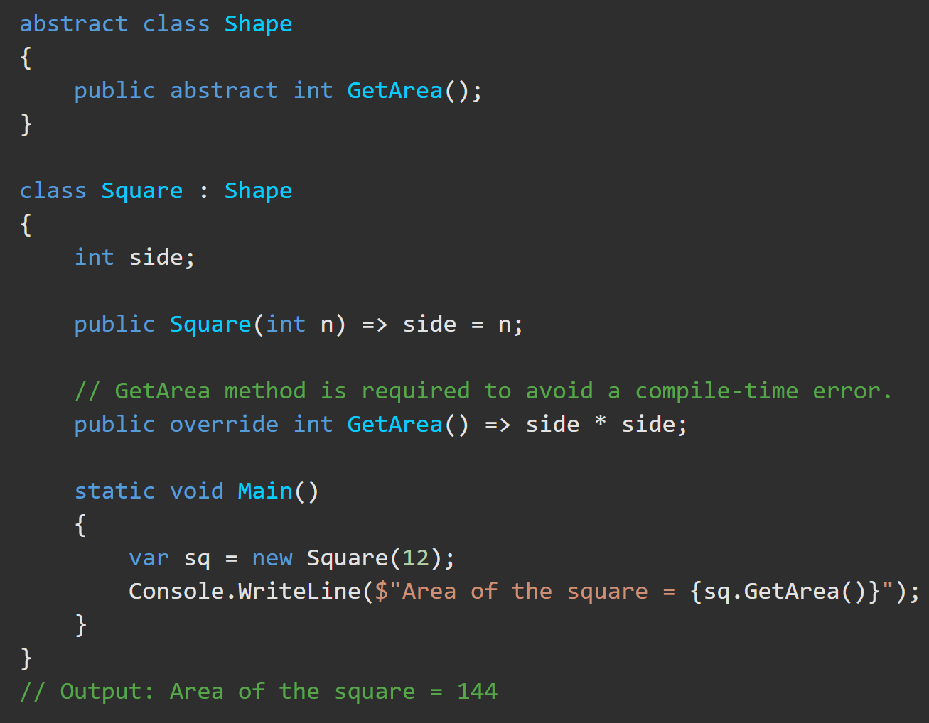
Modifiers – Override https://docs.microsoft.com/en-us/dotnet/csharp/language-reference/keywords/override
The override modifier is required to extend or modify the abstract or virtual implementation of an inherited method, property, indexer, or event.
ALL Override Members…
Must provide a new implementation of an inherited method
must have the same signature as the inherited method.
Can only override a virtual, abstract, or override method.
You cannot use the new, static, or virtual modifiers to modify an override method.

Slide 16
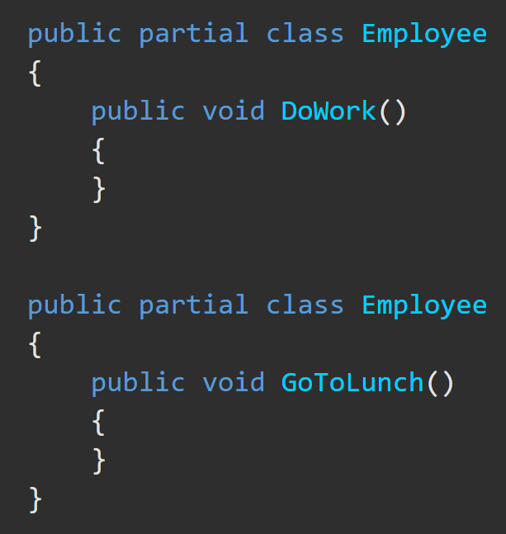
Partial Classes, Structs, Interfaces https://docs.microsoft.com/en-us/dotnet/csharp/programming-guide/classes-and-structs/partial-classes-and-methods
You can split the definition of a class, a struct, an interface or a method over two or more source files. Each source file contains a section. All parts are combined on compilation.
When would you do this?
When working with automatically generated source code can be added to the class without having to recreate the source file. Visual Studio uses this approach when it creates Windows Forms, Web service wrapper code, and so on. You can create code that uses these classes without having to modify the file created by Visual Studio.
Attributes, inherited classes, etc, are merged at compile-time.

